Slide 1

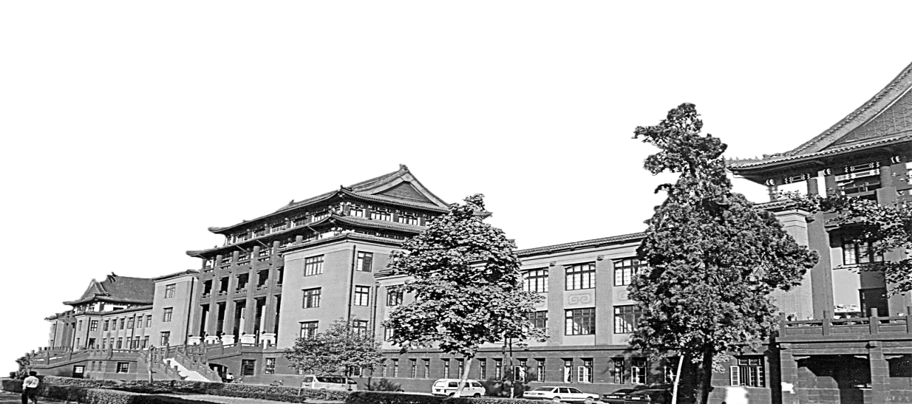
LIDIA: Lightweight Learned Image Denoising with Instance Adaptation
Gregory Vaksman, Michael Elad, Peyman Milanfar
CS Department - The Technion, Google Research, Google Research
CVPR2020
陈祥
2021.04.14

Slide 2
Contributions
1) Proposes a lightweight learnable architecture for image denoising, using a combination of supervised and unsupervised training of it.
2) Introduce a multi-scale treatment that combats spatial artifacts, especially noticeable in smooth regions.
3) network is more effective by operating in the
residual domain.
4) gives near-SOTA results while using a very
small number of parameters to be tuned 2

Slide 3
The second novelty
we present two ways for updating the universal network for any incoming image, so as to further improve its denoised result
A universally trained denoiser is necessarily less effective when handling images falling outside the training-set statistics;
While our universal denoiser does exploit self similarity, this can be further boosted for images with pronounced repetitions
As our universal denoiser is lightweight, even a single image example can be used for updating it without overfitting.

Slide 4
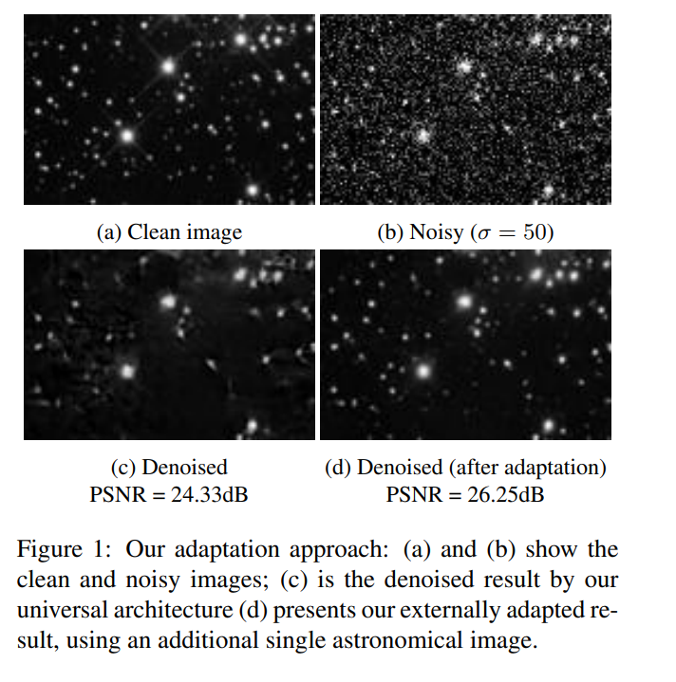
The second novelty
Retrain the universal network and better tune it
External boosting(adaption)
taking the universally denoised result and using it for searching the web for similar photos.
Taking even one such related image and performing few epochs of update to the network may improve the overall performance.
Extremely successful for images that deviate from the training-set.
Internal adaption:
re-trains the network on the denoised image itself (and a noisy version of it).
Quite effective for images with marked inner-similaries.

Slide 5
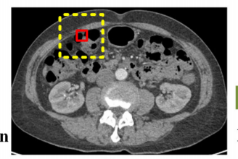

Traditional Methods-self similarity
BM3D,NLM,WNNM……
Both contain:
Grouping similar patches to 3D blocks and filtering them jointly,then fuse the blocks into their original positions

Slide 6
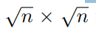
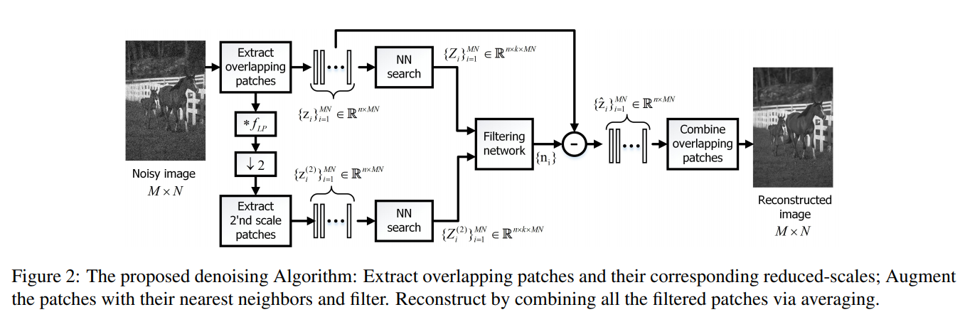
Overall Algorithm Overview
1. extracts all possible overlapping patches of size
it is not a part of the learnable architecture
2. cleans each in a similar way
3. combining these restored patches via averaging.

Slide 7
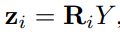
Overall Algorithm Overview
Search k-1 similar patches forming a matrix N*K, distance messure Euclidean metric,window b*b
Image size： M × N
corrupted and restored patches
Patch extraction

Slide 8
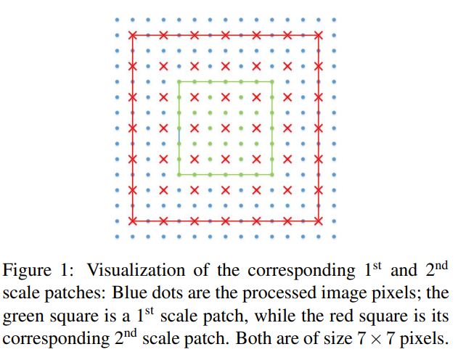
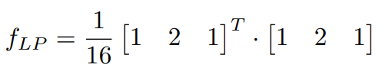
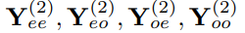
Multi-scale
High-resolution patches and their corresponding lower solution versions are jointly treated by assuming that they share the same sparse representation
Include two scales
The 1st scale is the original noisy image Y
The 2nd scale images are created by convolving Y with the low-pass filter
create four downscaled images by sampling the convolved image at either even or odd locations:
(even/odd columns & even/odd rows).

Slide 9
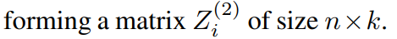
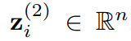
Multi-scale
For each 1st scale patch, the corresponding 2nd scale patch (of the same size √n ×√n) is extracted from the appropriate down-sampled image, such that both patches are centred at the same pixel in the original image.

Slide 10
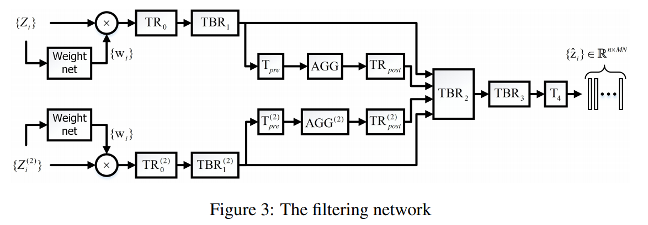
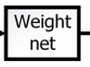
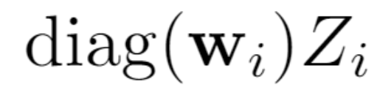
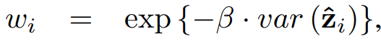
Filtering Network
Wi express the network’s belief regarding therelevance of each of the neighbor patches to the denoising process.
Consists of seven FC (Fully Connected) layers of size k × k with batch normalization and ReLU between each two FC’s.
Weight net input
β is learned

Slide 11
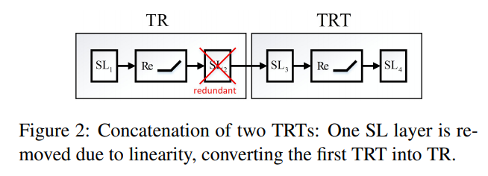
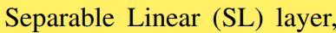
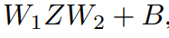
Filtering Network
1) A basic component
TRT (Transform–ReLU–Transform) block
Follows the classic Thresholding algorithm in sparse approximation theory in which denoising is obtained by transforming the incoming signal, discarding of small entries(this way getting a sparse representation), and applying an inverse transform that returns to the signal domain.
W1 and W2 operate in the spatial and the similarity domains.
2) Another basic component: TBR
TBR is a version of TR with batch normalization added before the ReLU.

Slide 12
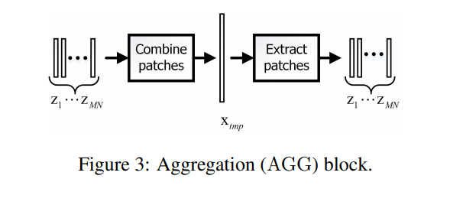
Filtering Network
Another component: Aggregation block (AGG).
1) This block imposes consistency between overlapping patches {zi} by combining them to a temporary image xtmp using plain averaging.
2) extracting them back from the obtained image

Slide 13
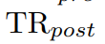
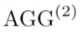
Filtering Network
the output of any TR or TBR component is in the feature
domain
transforms the AGG output back to the feature space, while imposing sparsit.
operates on downsampled patches, combinationand extraction is done with stride= 2
Reduced at the cost of a slight degradation in performanceby removing theTBR1,TBR(2)1 and TBR3 components

Slide 14
Image Adaptation
Capable of removing white additive Gaussian noise from all images by applying the same set of computations to all images.
If this machine is not adapted to the incoming image, which might deviate from the general statistics of the training corpus, or could
have an inner structure that is not fully exploited.
This lack of adaptation may imply reduced denoising performance.
Recent deep learning based methods adopted this approach, training on the corrupted image. However, their obtained performance tends to be non-competitive with fully supervised schemes.
Deep regression machines benefit from both supervised and single-image unsupervised training techniques

Slide 15
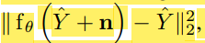
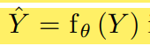
Image Adaptation
External Adaptation 类似 transfer learning
1) denoising the input image regularly
2) the network is re-trained and updated for few epochs.
seek (e.g., using Google image search) one or few other images closely related to the processed one, and re-train the network on this small set of clean images (and their noisy versions).
combine knowledge learned from an external dataset with knowledge that lies in the currently processed image, all while avoiding overfitting
Internal adaptation
1) denoising the input image regularly
2) network is re-trained on the denoised image itself using a loss function of the form
n is a synthetic noise
最后： enoising the input image by the updated network

Slide 16
Image Adaptation
External adaptation
Be chosen when handling images with special content that is not well represented in the training set. For example, this mode could be applied on non-natural images such as scanned documents.
External adaptation gains substantial improvement of more than 1dB in terms of PSNR.
Our external adaptation requires a single network for all images, requires less training images.
Internal adaptation becomes effective when the incoming image is characterized by a high level of self-similarity
gains a notable improvement of almost 0.3dB in PSNR on average

Slide 17
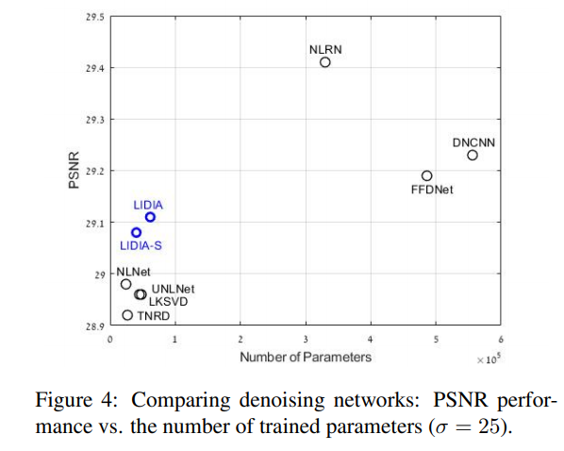
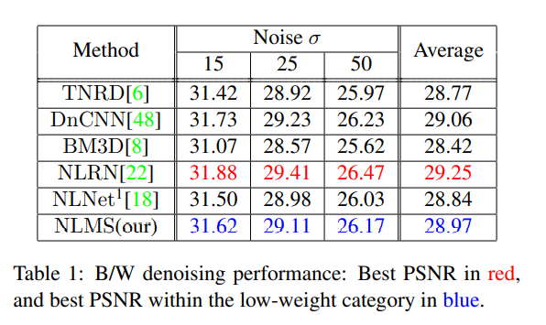
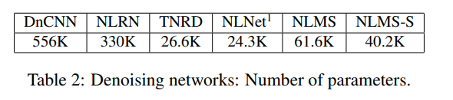
Experimental Results: Universal Denoising
Start with denoising experiments in which the noise is Gaussian white of known variance.
the best within the lightweight category, achieving a similar performance as CDnCNN

Slide 18
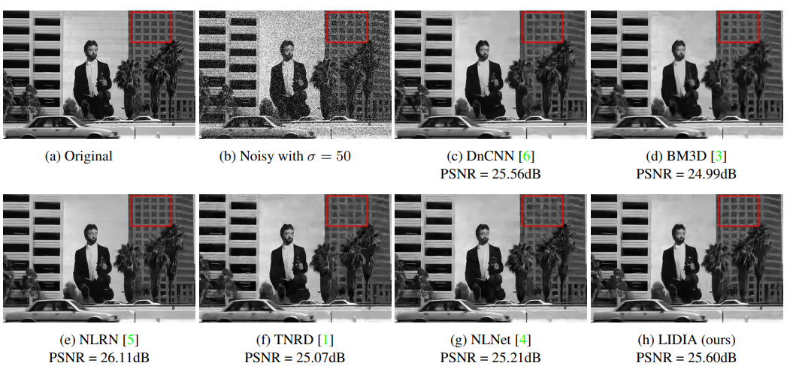
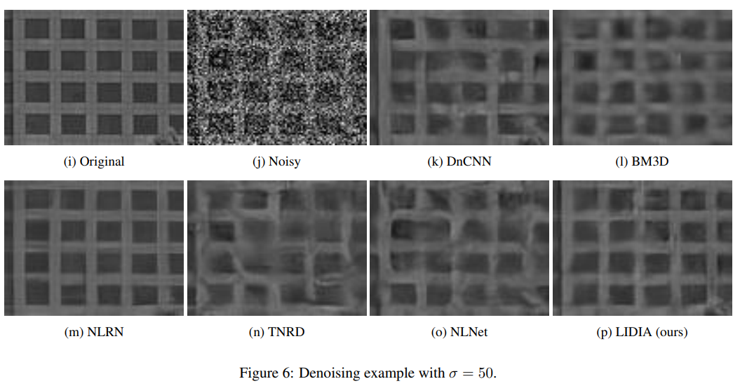
Experiments & Results-Gray Image

Slide 19
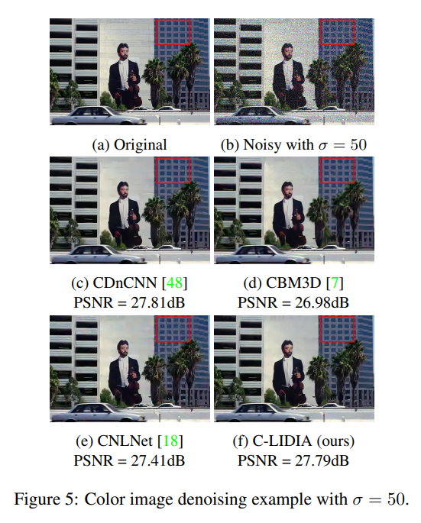
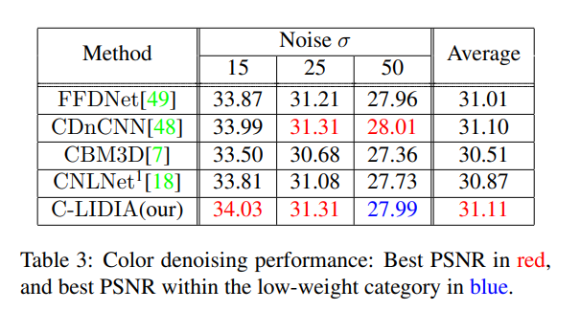
Experiments & Results color Image
For denoising of color images we use 3D patches of size 5 × 5 × 3 and increase the size of the matrices W1 from (49 × 64, 64 × 64, 64 × 49) to (75 × 80, 80 × 80, 80 × 75) accordingly, which increases the total number of our network’s parameters to 94K. The nearest neighbor search is done using the Luminance component, Y = 0.2989R+ 0.5870G+ 0.1140B

Slide 20
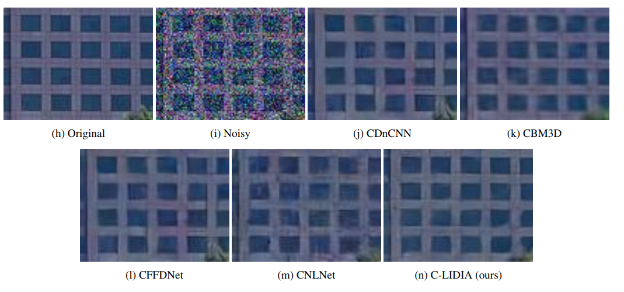
Experiments & Results color Image
Less artifacts and preserve more details than those of BM3D.
In comparison to NLNet, better in high noise levels due to our multiscale treatment, recovering large repeating element

Slide 21
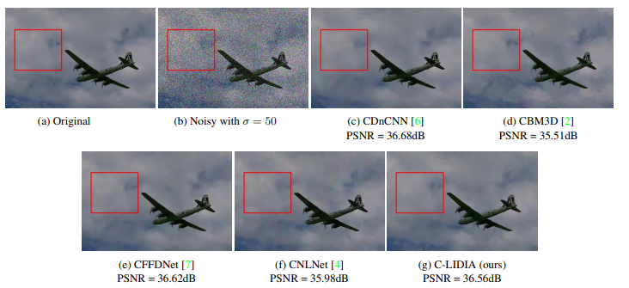
Experiments & Results- color Image

Slide 22
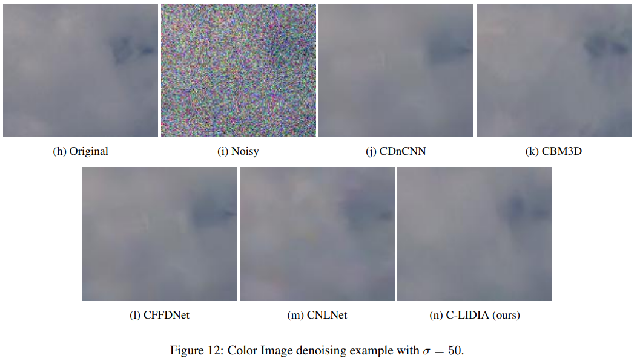
Experiments & Results- color Image

Slide 23
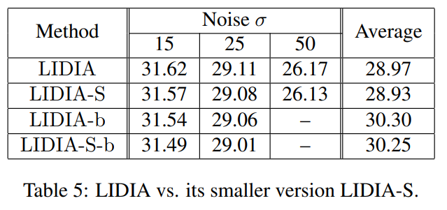
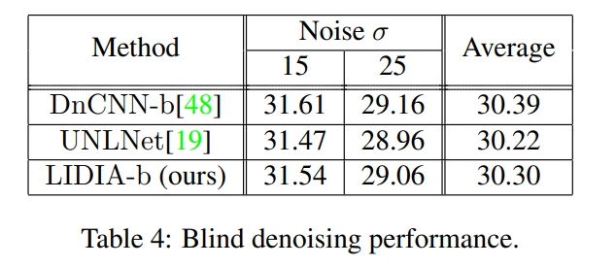
Experiments & Results between LIDIA and LIDIA-S
Two versions of it, LIDIA and LIDIA-S. The second is a simplified network with slightly weaker performance (see more below).
unknown noise level
LIDIA-S :removing the TBR1, TBR(2) 1 and TBR3 components. The resulting smaller network, denoted by LIDIA-S, contains 30% less parameters than the original LIDIA architecture.

Slide 24
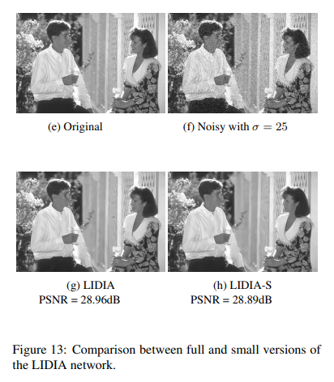
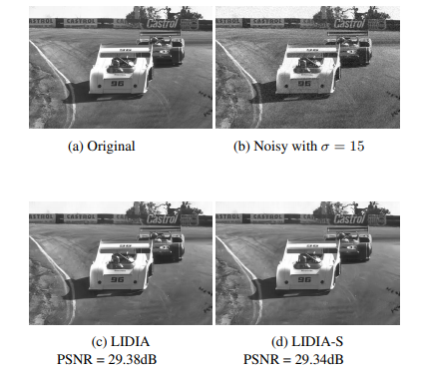
Experiments & Results between LIDIA and LIDIA-S

Slide 25
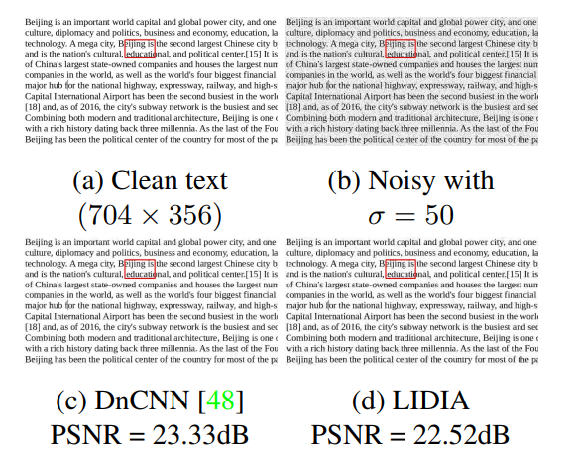
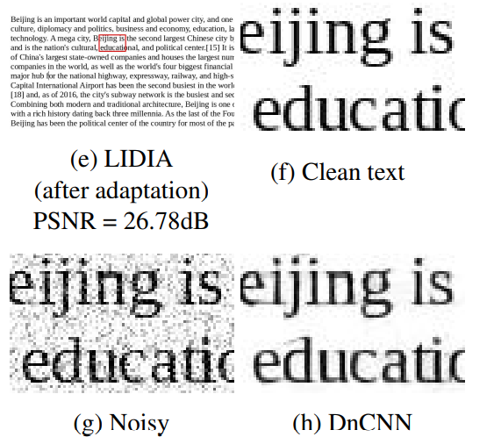
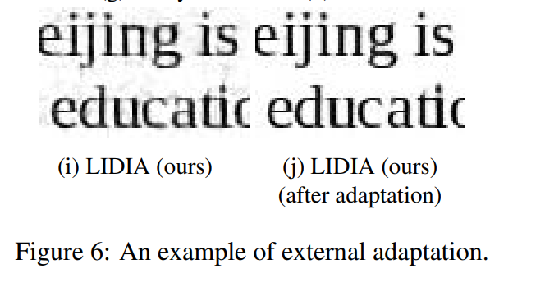
Experimental Results: Network Adaptation
All adaptation results are obtained via 5 epochs, requiring few minutes (depending on the image size) on Nvidia GeForce GTX 1080 Ti GPU.
The adaptation does not require early stopping – over-training the network leads to similar and sometimes better results.
External adaptation is useful when the input image deviates from the statistics of the training image

Slide 26
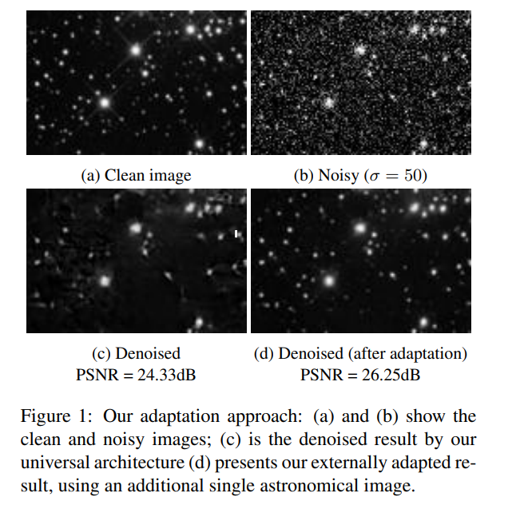
Experiments & Results external adaption

Slide 27
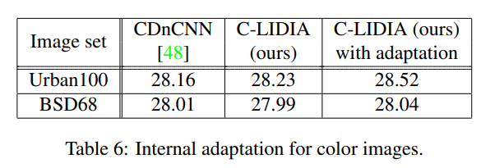
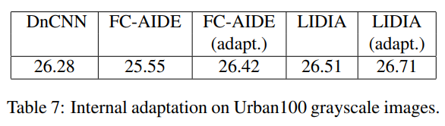
Experiments & Results- Internal adaptation
This difference can be attributed to the pronounced self similarity that is inherent in the Urban100 images

Slide 28
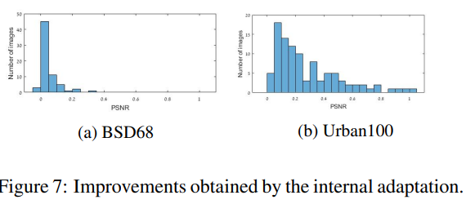
Experiments & Results- Internal adaptation
As evident from Figure 7a,
internal adaptation is not always successful,
and it may lead to slightly decreased PSNR.
However, among the 168 test images (BSD68 and Urban100)
only two such failures were encountered, both leading to a degradation of 0.02dB. We conclude that internal adaptation is robust and cannot do much harm.
Failures usually do not cause performance degradation, indicating that these procedures, in the context of being deployed on a lightweight network, do not overfit.

Slide 29
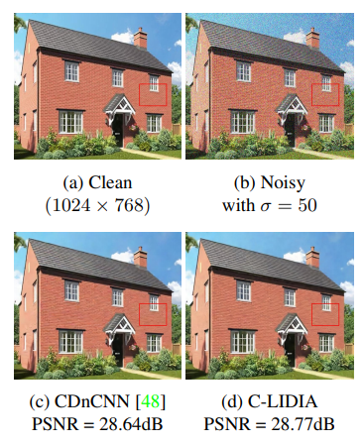
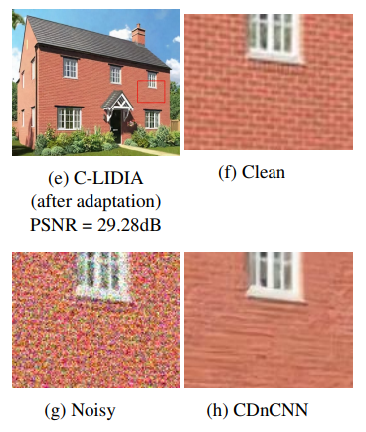
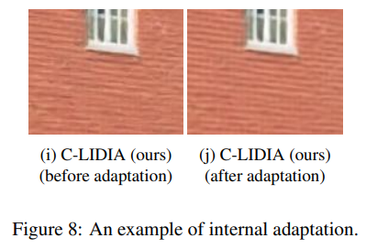
Experiments & Results- Internal adaptation

Slide 30
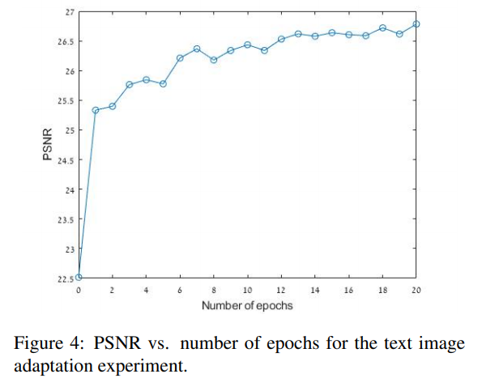
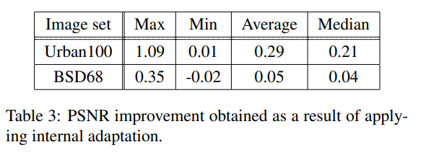
Experiments & Results

Slide 31
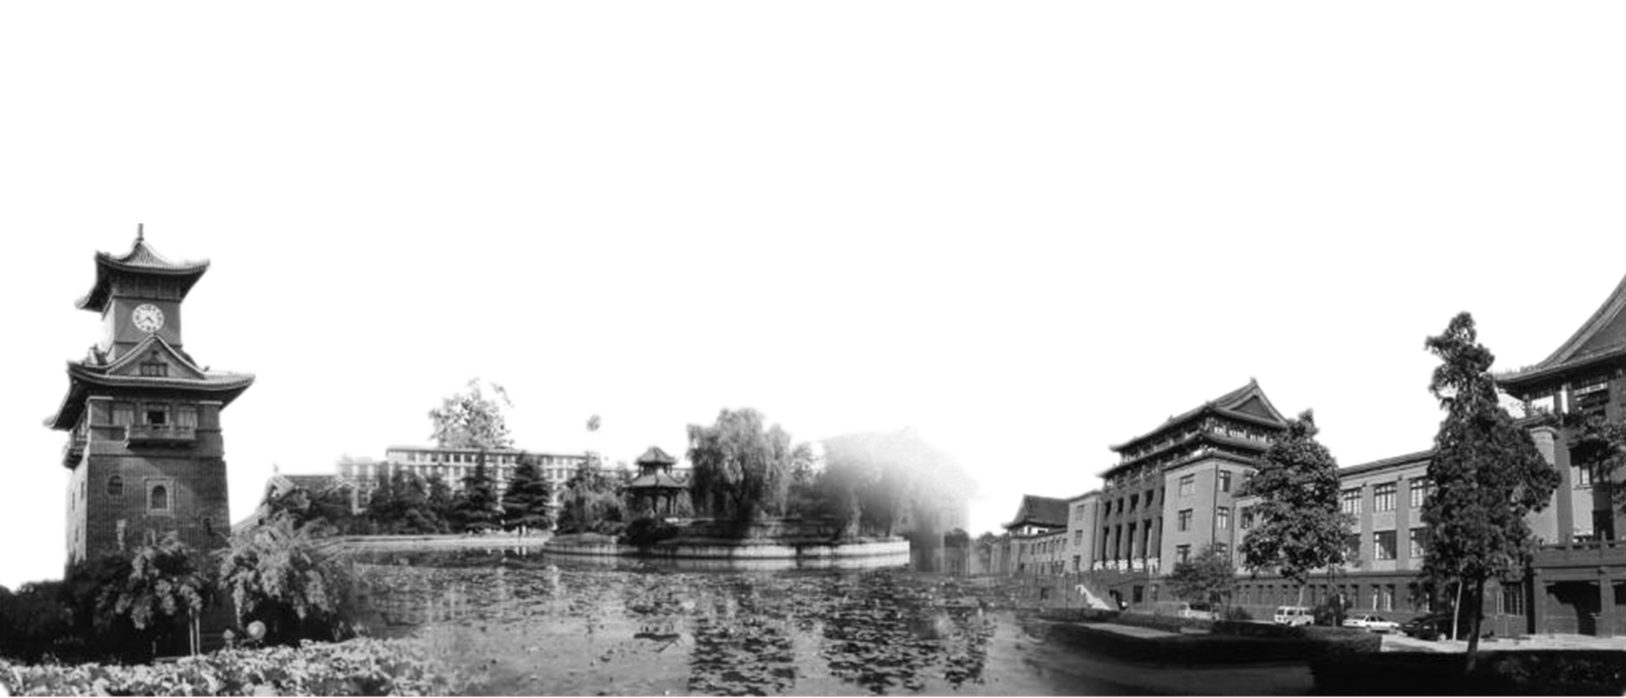
Thank You!

